Slide 1
Week 2 – Lecture Notes
Descriptive Analytics – Descriptive Statistics

Slide 2
Definition of Data and Goals of Using Data
Data: The facts and figures collected, analyzed, and summarized for presentation and interpretation.
Variable: A characteristic or a quantity of interest that can take on different values.
Observation: Set of values corresponding to a set of variables.
Variation: The difference in a variable measured over observations.
Random variable/uncertain variable: A quantity whose values are not known with certainty.
Notes:
When we collect data, we are gathering past observed values, or realizations of a variable.
By collecting these past realizations of one or more variables, our goal is to learn more about the variation of a particular business situation.

Slide 3
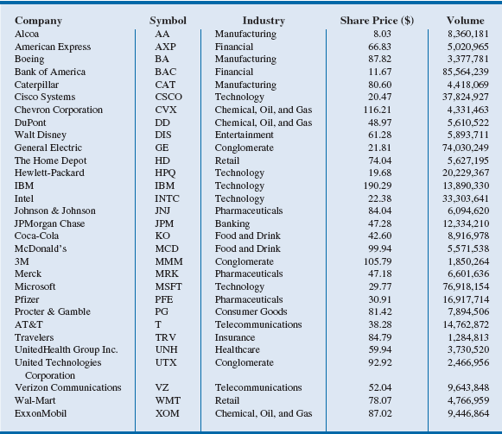
Table 2.1 - Data for Dow Jones Industrial Index Companies
Variable
Observations
Notes:
For the data in Table 2.1:
Variables: Symbol, Industry, Share Price, and Volume
Observation: Each row in Table 2.1
Variation: Time, customers, items, etc.

Slide 4
Types of Data

Slide 5
Types of Data
Population: A population is any complete group with at least one characteristic in common.
Sample: Subset of the population
Random sampling - A sampling method to gather a representative sample of the population data.
Notes:
Examples:
Population: With the thousands of publicly traded companies in the United States, tracking and analyzing all of these stocks every day would be too
time consuming and expensive.
Sample: The Dow represents a sample of 30 stocks of large public companies based in the United States, and it is often interpreted to represent
the larger population of all publicly traded companies.
Quantitative data: The values for Volume in the Dow data in Table 2.1 can be summed to calculate a total volume of all shares traded by companies included in the Dow.
Categorical data: The data in the Industry column in Table 2.1 are categorical - the number of companies in the Dow that are in the telecommunications industry can be counted.

Slide 6
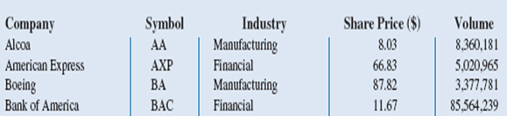
Types of Data
Quantitative data: Data on which numeric and arithmetic operations, such as addition, subtraction, multiplication, and division, can be performed.
Categorical data: Data on which arithmetic operations cannot be performed.
Categorical Data
Quantitative Data
Part of Table 2.1
Notes:
Examples:
Population: With the thousands of publicly traded companies in the United States, tracking and analyzing all of these stocks every day would be too
time consuming and expensive.
Sample: The Dow represents a sample of 30 stocks of large public companies based in the United States, and it is often interpreted to represent
the larger population of all publicly traded companies.
Quantitative data: The values for Volume in the Dow data in Table 2.1 can be summed to calculate a total volume of all shares traded by companies included in the Dow.
Categorical data: The data in the Industry column in Table 2.1 are categorical - the number of companies in the Dow that are in the telecommunications industry can be counted.

Slide 7
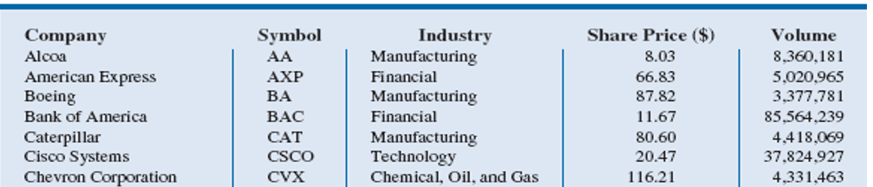
Types of Data
Cross-sectional data: Data collected from several entities at the same, or approximately the same point in time.
Example : Table 2.1 describes the 30 companies that comprise the Dow at the same point in time
Part of Table 2.1
Notes:
Example:
Cross-sectional data: The data in Table 2.1 is cross-sectional because it describes the 30 companies that comprise the Dow at the same point in time (April 2013).

Slide 8
Types of Data
Time series data: Data collected over several time periods.
Graphs of time series data are frequently found in business and economic publications.
Help analysts understand what happened in the past, identify trends over time, and project future levels for the time series.
Next slide shows an example.
Notes:
Example:
Cross-sectional data: The data in Table 2.1 are cross-sectional because they describe the 30 companies that comprise the Dow at the same point in time (April 2013).

Slide 9
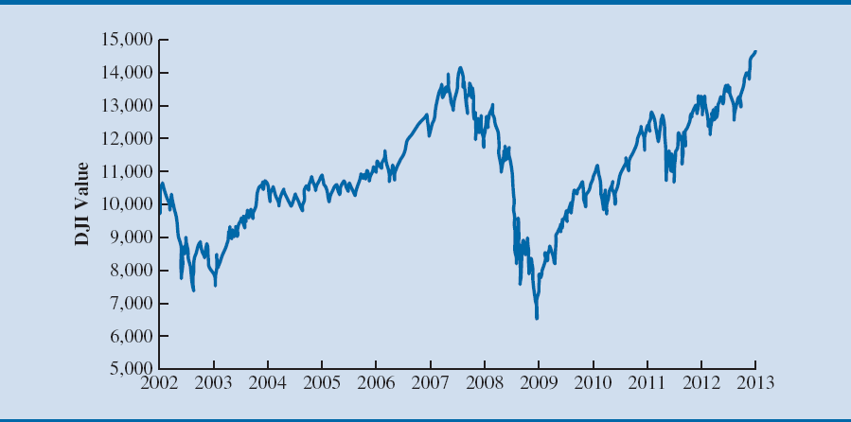
Figure 2.1 - Dow Jones Index Values Since 2002
Notes:
Example: (contd.)
Time series data: Figure 2.1 illustrates that the DJI was near 10,000 in 2002 and climbed to above 14,000 in 2007. However, the financial crisis in 2008 led to a significant decline in the DJI to between 6000 and 7000 by 2009. Since 2009, the DJI has been generally increasing and topped 14,000 in April 2013.

Slide 10
Types of Data
Sources of data
Experimental study - A variable of interest is first identified.
Then one or more other variables are identified and controlled or manipulated so that data can be obtained about how they influence the variable of interest.
Nonexperimental study or observational study - Make no attempt to control the variables of interest.
A survey is perhaps the most common type of observational study.
Notes:
Example:
Experimental study:
If a pharmaceutical firm is interested in conducting an experiment to learn about how a new drug affects blood pressure, then blood pressure is the variable of interest in the study.
The dosage level of the new drug is another variable that is hoped to have a causal effect on blood pressure.
To obtain data about the effect of the new drug, researchers select a sample of individuals.
The dosage level of the new drug is controlled as different groups of individuals are given different dosage levels.
Before and after the study, data on blood pressure are collected for each group.
Statistical analysis of these experimental data can help determine how the new drug affects blood pressure.

Slide 11

Figure 2.2 - Customer Opinion Questionnaire used by Chops City Grill Restaurant
Notes:
Example: (contd.)
Nonexperimental study:
Figure 2.2 shows a customer opinion questionnaire used by Chops City Grill in Naples, Florida.
Note that the customers who fill out the questionnaire are asked to provide ratings for 12 variables, including overall experience, the greeting by hostess, the table visit by the manager, overall service, and so on.
The response categories of excellent, good, average, fair, and poor provide categorical data that enable Chops City Grill management to maintain high standards for the restaurant’s food and service.
In some cases, the data needed for a particular application already exist from an experimental or observational study already conducted.
Companies maintain a variety of databases about their employees, customers, and business operations.

Slide 12
Creating Distributions from Data

Slide 13
Creating Distributions from Data
Frequency distributions for categorical data
Frequency distribution: A summary of data that shows the number (frequency) of observations in each of several nonoverlapping classes, typically referred to as bins, when dealing with distributions.

Slide 14
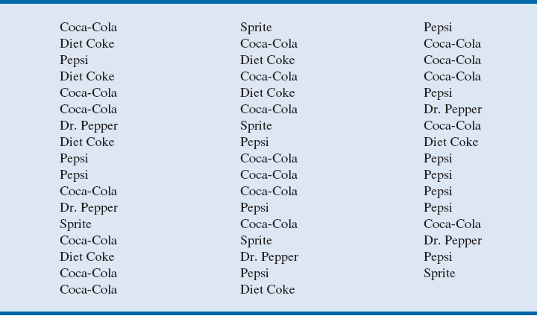
Table 2.3 - Data from a Sample of 50 Soft Drink Purchases
Notes:
The data in Table 2.3 is taken from a sample of 50 soft drink purchases.
Each purchase is for one of five popular soft drinks, which defines the five bins: Coca-Cola, Diet Coke, Dr. Pepper, Pepsi, and Sprite.

Slide 15
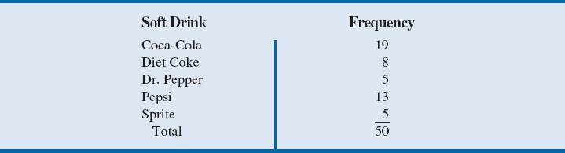
Table 2.4 - Frequency Distribution of Soft Drink Purchases
The frequency distribution summarizes information about the popularity of the five soft drinks:
Coca-Cola is the leader
Pepsi is second,
Diet Coke is third, and
Sprite and Dr. Pepper are tied for fourth.
Notes:
The frequency distribution of soft drink purchases (table 2.4) is obtained by counting the number of times each soft drink appears in Table 2.3.
Coca-Cola appears 19 times, Diet Coke appears 8 times, Dr. Pepper appears 5 times, Pepsi appears 13 times, and Sprite appears 5 times.
This frequency distribution provides a summary of how the 50 soft drink purchases are distributed across the five soft drinks.

Slide 16
Table from a Sample of 50 Soft Drink Purchases VS Frequency Distribution table
Analysis of this table is not easy
This table is easier for analysis
Notes:
The data in Table 2.3 is taken from a sample of 50 soft drink purchases.
Each purchase is for one of five popular soft drinks, which defines the five bins: Coca-Cola, Diet Coke, Dr. Pepper, Pepsi, and Sprite.

Slide 17
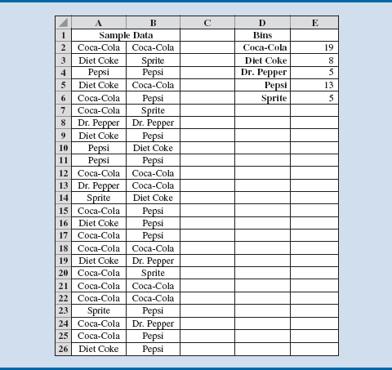
Figure 2.9 - Creating a Frequency Distribution for Soft Drinks Data in Excel
Notes:
Figure 2.9 shows the sample of 50 soft drink purchases in an Excel spreadsheet.
Column D contains the five different soft drink categories as the bins.
In cell E2, enter the formula =COUNTIF($A$2:$B$26, D2), where A2:B26 is the range for the sample data, and D2 is the bin (Coca-Cola) to match.
The COUNTIF function in Excel counts the number of times a certain value appears in the indicated range.
In this case, we want to count the number of times Coca-Cola appears in the sample data. The result is a value of 19 in cell E2, indicating that Coca-Cola appears 19 times in the sample data.
The formula from cell E2 to cells E3 to E6 can be copied to get frequency counts for Diet Coke, Pepsi, Dr. Pepper, and Sprite. By using the absolute reference $A$2:$B$26 in the formula.

Slide 18
Creating Distributions from Data
Relative frequency and percent frequency distributions
Relative frequency distribution: It is a tabular summary of data showing the relative frequency for each bin.
Percent frequency distribution: Summarizes the percent frequency of the data for each bin.
Used to provide estimates of the relative likelihoods of different values of a random variable.

Slide 19
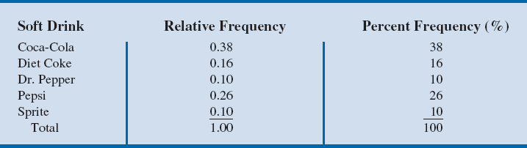
Table 2.5 - Relative Frequency and Percent Frequency Distributions of Soft Drink Purchases
Notes:
Table 2.4 shows that the relative frequency for Coca-Cola is 19/50 = 0.38, the relative frequency for Diet Coke is 8/50 = 0.16, and so on.
From the percent frequency distribution, it is seen that 38 percent of the purchases were Coca-Cola, 16 percent of the purchases were Diet Coke, and so on.
Note that 38 percent + 26 percent + 16 percent = 80 percent of the purchases were the top three soft drinks.

Slide 20
Creating Distributions from Data
Frequency distributions for quantitative data
Three steps necessary to define the classes for a frequency distribution with quantitative data determine:
1. The number of nonoverlapping bins.
2. The width of each bin.
3. The bin limits.
Notes:
Number of bins:
Bins are formed by specifying the ranges used to group the data.
Generally, between 5 and 20 bins are in use.
Small number of data items - five or six bins.
Larger number of data items - more bins are required.
The goal is to use enough bins to show the variation in the data, but not so many classes that some contain only a few data items.
Width of the bins:
It should be the same for each bin.
Thus the choices of the number of bins and the width of bins are not independent decisions.
A larger number of bins means a smaller bin width and vice versa.
Approximate bin width = $\frac{\text{Largest} \text{data} \text{value} − \text{smallest} \text{data} \text{value}}{\text{Number} \text{of} \text{bins}}$
Bin limits:
Bin limits must be chosen so that each data item belongs to one and only one class.
The lower bin limit identifies the smallest possible data value assigned to the bin.
The upper bin limit identifies the largest possible data value assigned to the class.

Slide 21
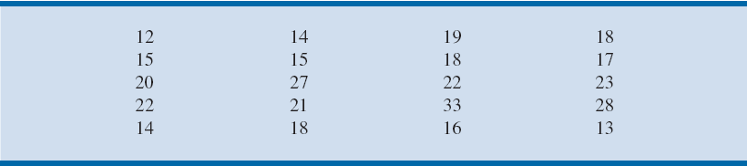
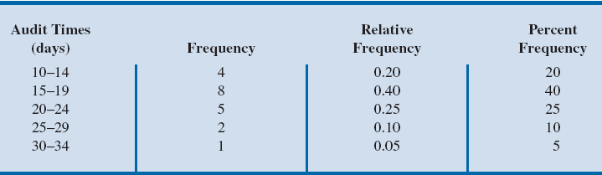
Creating Distributions from Data
Table 2.6 - Year-End Audit Times (Days)
Table 2.7 - Frequency, Relative Frequency, and Percent Frequency
Distributions for the Audit Time Data
Notes:
Number of bins:
The number of data items in Table 2.6 is relatively small (n = 20). Hence, we choose to develop a frequency distribution with five bins.
Width of bins:
The largest data value is 33, and the smallest data value is 12.
Because we decided to summarize the data with five classes, using the expression “Approximate bin width = $\frac{\text{Largest} \text{data} \text{value} − \text{smallest} \text{data} \text{value}}{\text{Number} \text{of} \text{bins}}$”, provides an approximate bin width of (33 – 12)/5 = 4.2.
We therefore decided to round up and use a bin width of five days in the frequency distribution.
Bin limits:
We selected 10 days as the lower bin limit and 14 days as the upper bin limit for the first class. This bin is denoted 10–14 in Table 2.7.
The smallest data value, 12, is included in the 10–14 bin. We then selected 15 days as the lower bin limit and 19 days as the upper bin limit of the next class.
We continued defining the lower and upper bin limits to obtain a total of five classes: 10–14, 15–19, 20–24, 25–29, and 30–34.
The difference between the upper bin limits of adjacent bins is the bin width. Using the first two upper bin limits of 14 and 19, we see that the bin width is 19 – 14 = 5.
With the number of bins, bin width, and bin limits determined, a frequency distribution can be obtained by counting the number of data values belonging to each bin.
Using the frequency distribution in Table 2.7, we can observe that:
The most frequently occurring audit times are in the bin of 15–19 days.
Eight of the 20 audit times are in this bin.
Only one audit required 30 or more days.

Slide 22
Creating Distributions from Data
Table 2.6 - Year-End Audit Times (Days)
Table 2.7 - Frequency, Relative Frequency, and Percent Frequency
Distributions for the Audit Time Data
width of each bin is 4
Notes:
Number of bins:
The number of data items in Table 2.6 is relatively small (n = 20). Hence, we choose to develop a frequency distribution with five bins.
Width of bins:
The largest data value is 33, and the smallest data value is 12.
Because we decided to summarize the data with five classes, using the expression “Approximate bin width = $\frac{\text{Largest} \text{data} \text{value} − \text{smallest} \text{data} \text{value}}{\text{Number} \text{of} \text{bins}}$”, provides an approximate bin width of (33 – 12)/5 = 4.2.
We therefore decided to round up and use a bin width of five days in the frequency distribution.
Bin limits:
We selected 10 days as the lower bin limit and 14 days as the upper bin limit for the first class. This bin is denoted 10–14 in Table 2.7.
The smallest data value, 12, is included in the 10–14 bin. We then selected 15 days as the lower bin limit and 19 days as the upper bin limit of the next class.
We continued defining the lower and upper bin limits to obtain a total of five classes: 10–14, 15–19, 20–24, 25–29, and 30–34.
The difference between the upper bin limits of adjacent bins is the bin width. Using the first two upper bin limits of 14 and 19, we see that the bin width is 19 – 14 = 5.
With the number of bins, bin width, and bin limits determined, a frequency distribution can be obtained by counting the number of data values belonging to each bin.
Using the frequency distribution in Table 2.7, we can observe that:
The most frequently occurring audit times are in the bin of 15–19 days.
Eight of the 20 audit times are in this bin.
Only one audit required 30 or more days.

Slide 23
Creating Distributions from Data
Histogram: A common graphical presentation of quantitative data
Constructed by placing the variable of interest on the horizontal axis and the selected frequency measure (absolute frequency, relative frequency, or percent frequency) on the vertical axis.
The frequency measure of each class is shown by drawing a rectangle whose base is determined by the class limits on the horizontal axis and whose height is the corresponding frequency measure.

Slide 24
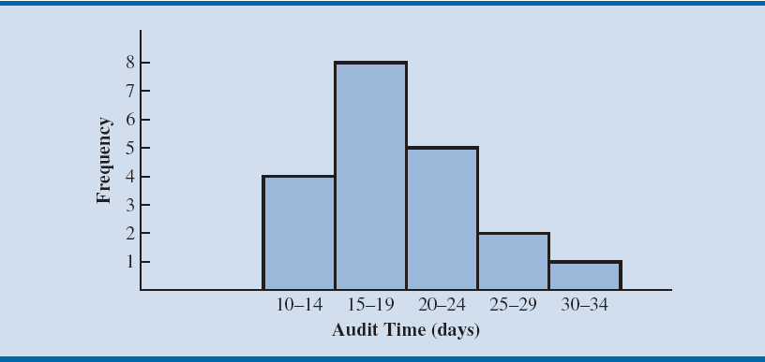
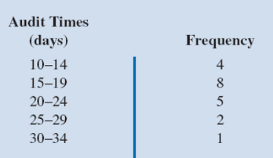
Figure 2.11 - Histogram for the Audit Time Data
Frequency value
Notes:
In figure 2.11, note that the class with the greatest frequency is shown by the rectangle appearing above the class of 15–19 days.
The height of the rectangle shows that the frequency of this class is 8.

Slide 25
Creating Distributions from Data
Histogram provides information about the shape, or form of a distribution.
Skewness: Lack of symmetry
Important characteristic of the shape of a distribution

Slide 26
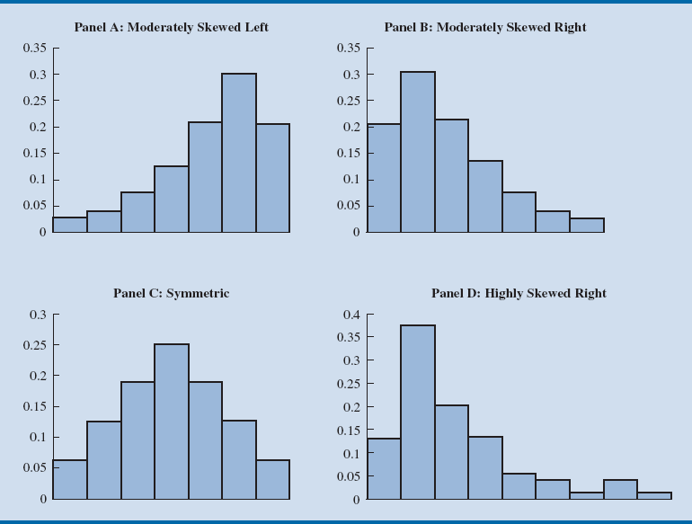
Figure 2.14 - Histograms Showing Distributions with Different Levels of Skewness
Notes:
Panel A: Moderately skewed to the left
Here, tail extends farther to the left than to the right.
Example: Exam scores, with no scores above 100 percent, most of the scores above 70 percent, and only a few really low scores.
Panel B: Moderately skewed to the right
Tail extends farther to the right than to the left.
Example: Housing prices; a few expensive houses create the skewness in the right tail.
Panel C: Symmetric
The left tail mirrors the shape of the right tail.
Example: Data for SAT scores, the heights and weights of people, and so on lead to histograms that are roughly symmetric.
Panel D: Highly skewed to the right
Example: Data on housing prices, salaries, purchase amounts, and so on often result in histograms skewed to the right.

Slide 27
Creating Distributions from Data
Cumulative frequency distribution: A variation of the frequency distribution that provides another tabular summary of quantitative data.
Uses the number of classes, class widths, and class limits developed for the frequency distribution.
Shows the number of data items with values less than or equal to the upper class limit of each class.

Slide 28
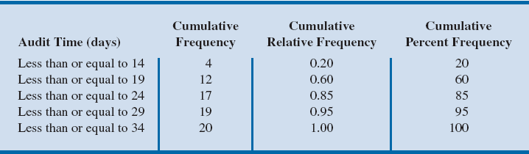
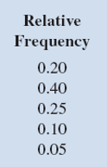
Table 2.8 - Cumulative Frequency, Cumulative Relative Frequency, and Cumulative Percent Frequency Distributions for the Audit Time
0.20+0.40=0.60; 0.60+0.25=0.85
Notes:
Consider the class with the description “Less than or equal to 24.”
The cumulative frequency for this class is simply the sum of the frequencies for all classes with data values less than or equal to 24.
The sum of the frequencies for classes 10–14, 15–19, and 20–24 indicates that 4 + 8 + 5 = 17 data values are less than or equal to 24. Hence, the
cumulative frequency for this class is 17.
In addition, the cumulative frequency distribution in Table 2.8 shows that four audits were completed in 14 days or less and that 19 audits were completed in 29 days or less.
The cumulative relative frequency distribution can be computed either by summing the relative frequencies in the relative frequency distribution or by dividing the cumulative frequencies by the total number of items.
Using the latter approach, we found the cumulative relative frequencies in column 3 of Table 2.8 by dividing the cumulative frequencies in column 2 by the total number of items (n = 20).
The cumulative percent frequencies were again computed by multiplying the relative frequencies by 100.
The cumulative relative and percent frequency distributions show that 0.85 of the audits, or 85 percent, were completed in 24 days or less, 0.95 of the audits, or 95 percent, were completed in 29 days or less, and so on.

Slide 29
Additional Reading - Measures of Location

Slide 30
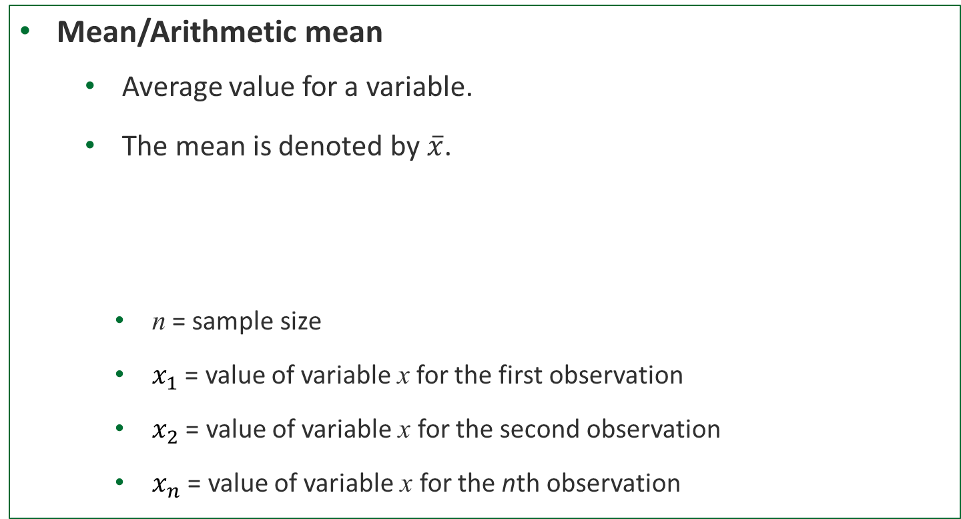
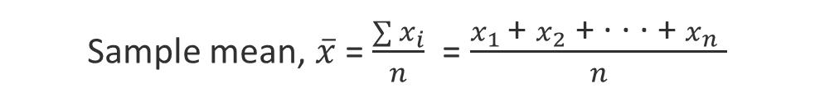
Measures of Location
Mean/Arithmetic mean
Average value for a variable.
The mean is denoted by $\overline{x}$.
n = sample size
$x_{1}$ = value of variable x for the first observation
$x_{2}$ = value of variable x for the second observation
$x_{n}$ = value of variable x for the nth observation
Sample mean, $\overline{x}$ = $\frac{\sum{x_{i}}}{n}$ = $\frac{x_{1} \text{+ }x_{2}\text{ + · · · + }x_{n} }{n}$
Notes:
Arithmetic Mean:
Provides a measure of central location for the data.
Denoted by $\overline{x}$for sample data.
Denoted by µ for population data.

Slide 31
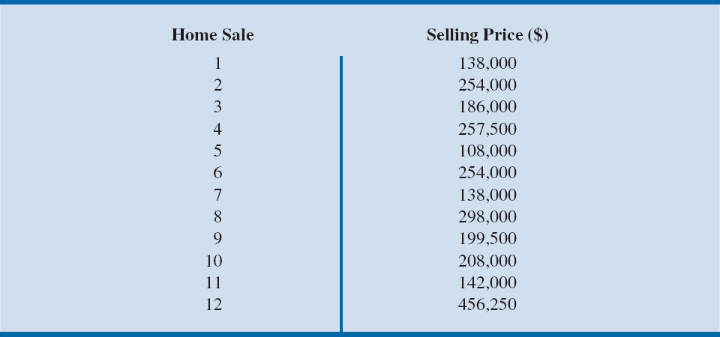
Table 2.9 - Data on Home Sales in Cincinnati, Ohio, Suburb
Illustration: Computation of the mean home selling price for the sample of 12 home sales:

Slide 32
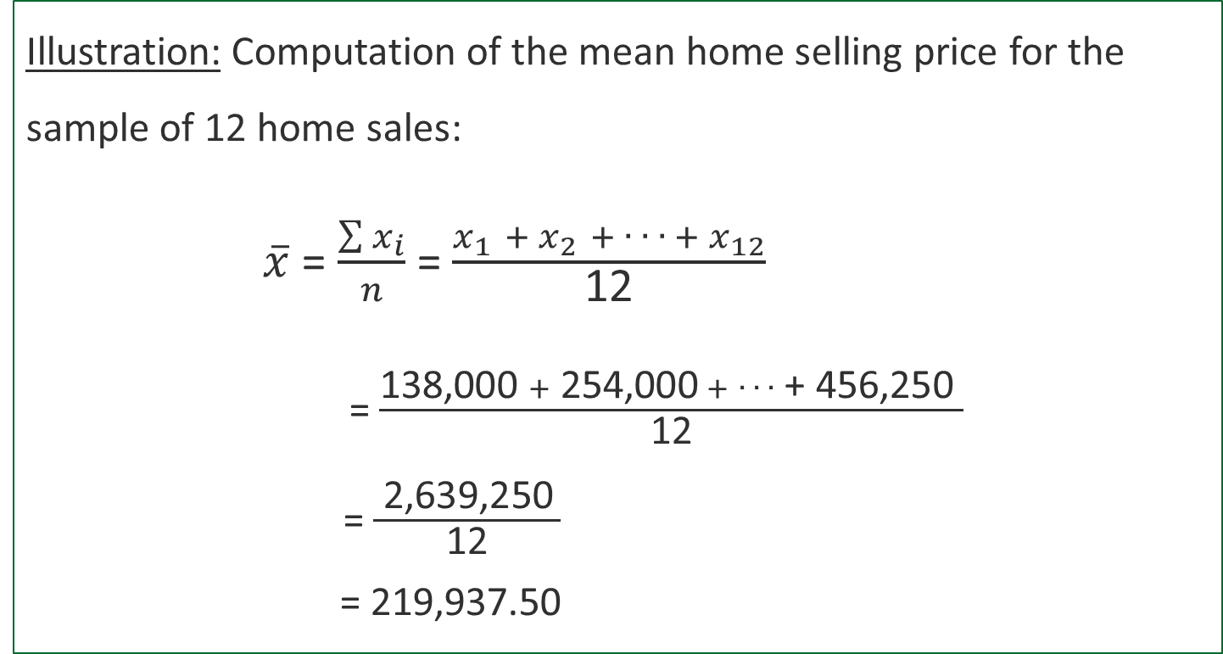
Computation of Sample Mean
Illustration: Computation of the mean home selling price for the sample of 12 home sales:
$\overline{x}$ = $\frac{\sum{x_{i}}}{n}$ = $\frac{x_{1} {+ x}_{2} + ∙ ∙ {∙ + x}_{12}}{\text{12}}$
= $\frac{\text{138,000 }+ \text{254,000} + ∙ ∙ ∙\text{ + }\text{456,250 }}{\text{12}}$
= $\frac{ \text{2}\text{,639}\text{,}\text{25}\text{0} }{\text{12}}$
= 219,937.50

Slide 33
Measures of Location
Median: Value in the middle when the data is arranged in ascending order.
Middle value, for an odd number of observations
Average of two middle values, for an even number of observations

Slide 34
Computation of Sample Median
Illustration - When the number of observations is odd
Consider the class size data for a sample of five college classes:
46 54 42 46 32
Arrange the class size data in ascending order .
32 42 46 46 54
Middlemost value in the data set = 46.
Median is 46.
Notes:
Because n = 5 is odd, median is the middlemost value in the data set, 46.

Slide 35
Computation of Sample Median (odd)
Illustration - When the number of observations is odd
Consider the class size data for a sample of five college classes:
46 54 42 46 32
Arrange the class size data in ascending order .
32 42 46 46 54
Middlemost value in the data set = 46.
Median is 46.
Notes:
Because n = 5 is odd, median is the middlemost value in the data set, 46.

Slide 36
Computation of Sample Median
Illustration - When the number of observations is even
Consider the data on home sales in Cincinnati, Ohio, Suburb:

Slide 37
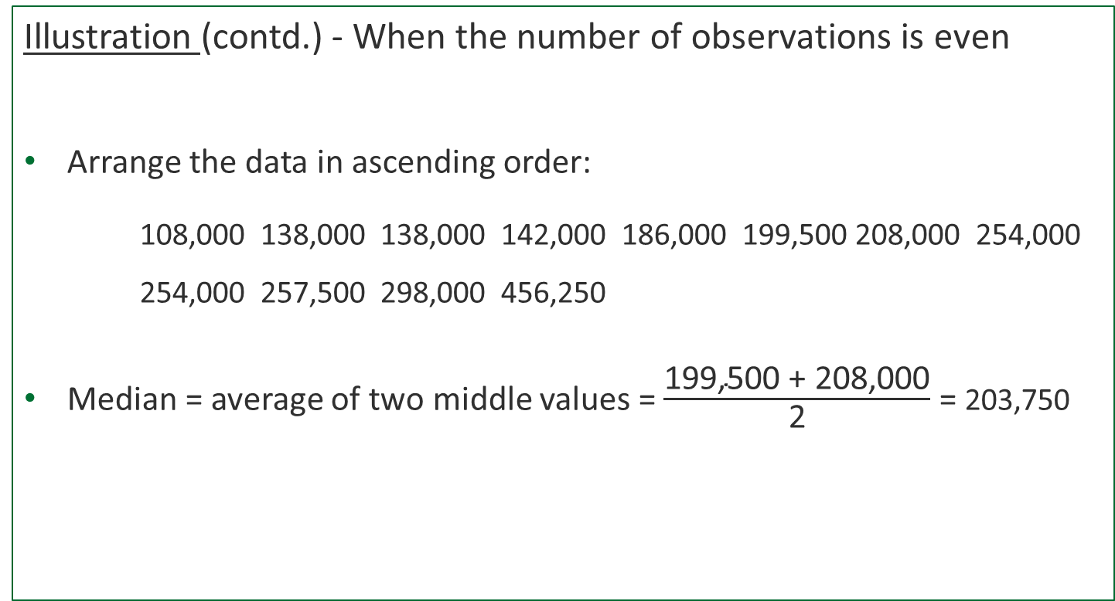
Computation of Sample Median
Illustration (contd.) - When the number of observations is even
Arrange the data in ascending order:
108,000 138,000 138,000 142,000 186,000 199,500 208,000 254,000 254,000 257,500 298,000 456,250
Median = average of two middle values = $\frac{\text{199,500} \text{+}\text{ 208}\text{,}\text{0}\text{00}}{\text{2}}$ = 203,750
Middle Two Values
Notes:
Because n = 12 is even, the median is the average of the middle two values: 199,500 and 208,000.

Slide 38
Measures of Location
Mode: Value that occurs most frequently in a data set.
Consider the class size data:
32 42 46 46 54
Observe - 46 is the only value that occurs more than once.
Mode is 46.
Multimodal data - Data contain at least two modes.
Bimodal data - Data contain exactly two modes.

Slide 39
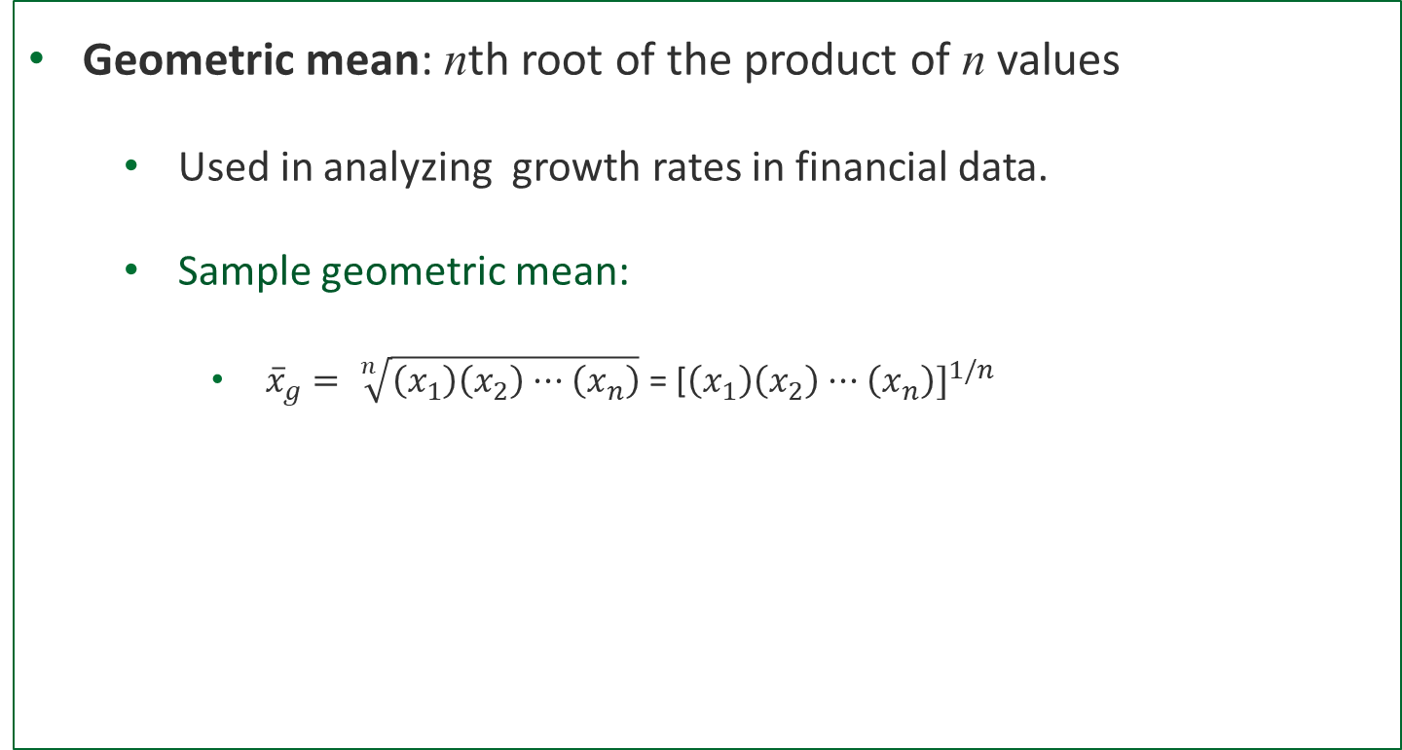
Measures of Location
Geometric mean: nth root of the product of n values
Used in analyzing growth rates in financial data.
Sample geometric mean:
${\overline{x}}_{g}= \sqrt[n]{\left(x_{1}\right)\left(x_{2}\right)···\left(x_{n}\right)}$ = [$\left(x_{1}\right)\left(x_{2}\right)···\left(x_{n}\right)]^{1/n}$

Slide 40
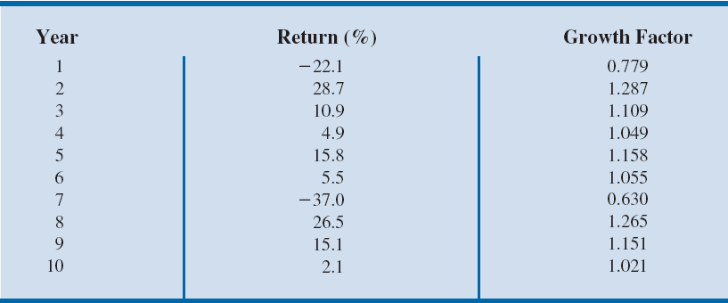
Table 2.10 - Percentage Annual Returns and Growth Factors for the Mutual Fund Data
Illustration - Consider the percentage annual returns and growth factors for the mutual fund data over the past 10 years.
We will determine the mean rate of growth for the fund over the 10-year period.

Slide 41
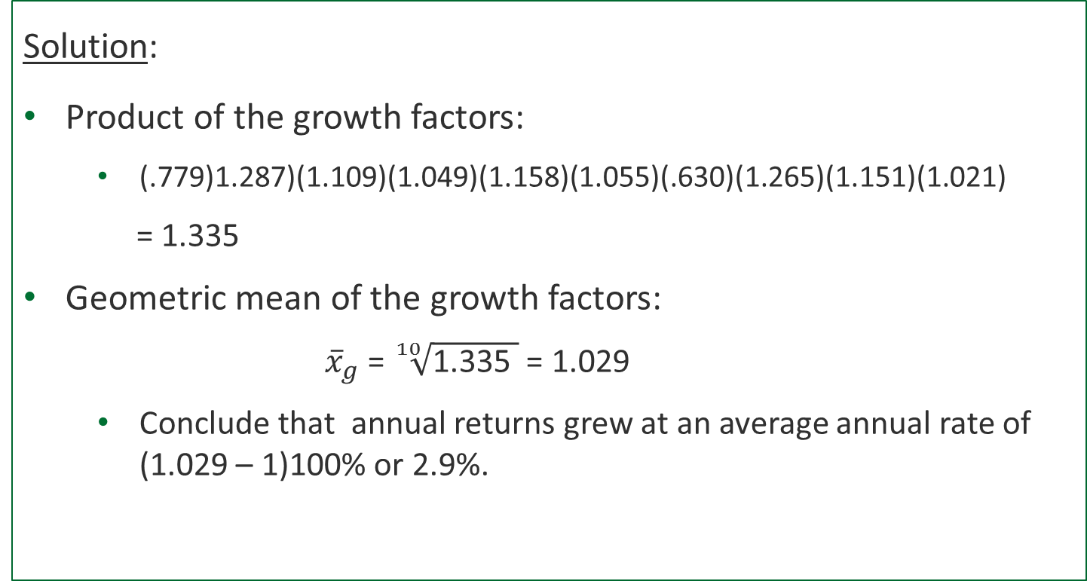
Computation of Geometric Mean
Solution:
Product of the growth factors:
(.779)1.287)(1.109)(1.049)(1.158)(1.055)(.630)(1.265)(1.151)(1.021)
= 1.335
Geometric mean of the growth factors:
${\overline{x}}_{g}$ = $\sqrt[10]{\text{1}\text{.}\text{33}\text{5} }$ = 1.029
Conclude that annual returns grew at an average annual rate of (1.029 – 1)100% or 2.9%.

Slide 42
Additional Reading - Measures of variability

Slide 43
Measures of Variability
Range: Found by subtracting the smallest value from the largest value in a data set.
Illustration: Consider the data on home sales in Cincinnati, Ohio, Suburb:

Slide 44
Computation of Range
Illustration (contd.):
Largest home sales price - $456,250
Smallest home sales price - $108,000
Range = Largest value – Smallest value
= $456,250 – $108,000
= $348,250
Drawback: Range is based on only two of the observations and thus is highly influenced by extreme values.

Slide 45
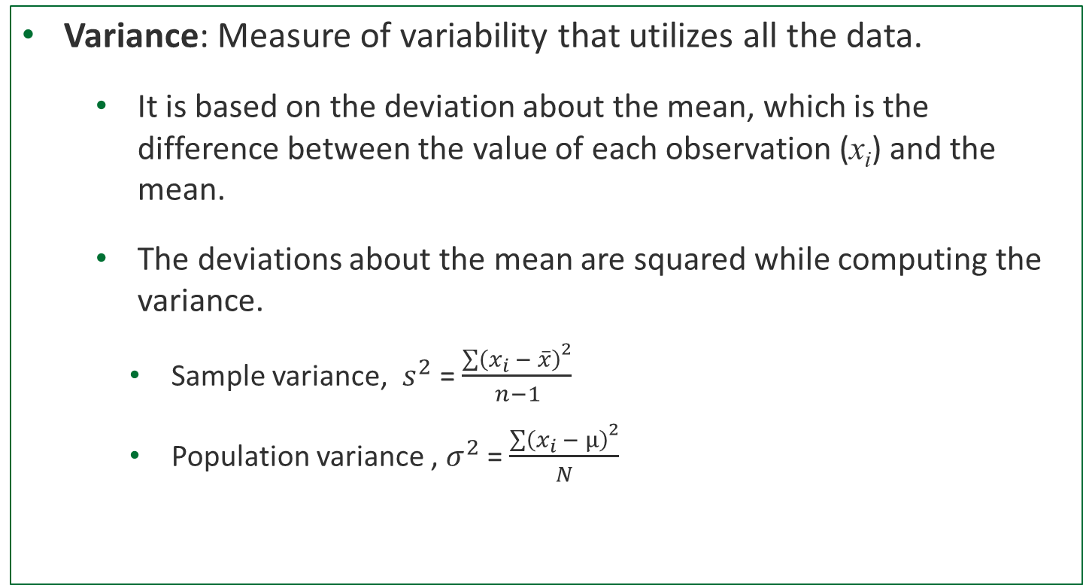
Measures of Variability
Variance: Measure of variability that utilizes all the data.
It is based on the deviation about the mean, which is the difference between the value of each observation (x_{i}) and the mean.
The deviations about the mean are squared while computing the variance.
Sample variance, $s^{2}$ = $\frac{{\sum{\left(x_{i} − \overline{x}\right)}}^{2}}{n−1}$
Population variance , $σ^{2}$ = $\frac{{\sum{\left(x_{i} − µ\right)}}^{2}}{N}$

Slide 46
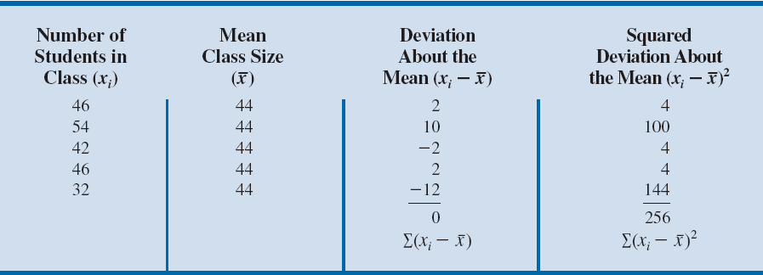
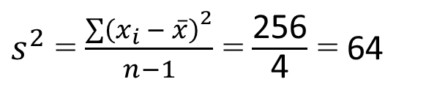
Table 2.12 - Computation of Deviations and Squared Deviations about the Mean for the Class Size Data
Computation of Sample Variance:
$s^{2}$ = $\frac{{\sum{\left(x_{i} − \overline{x}\right)}}^{2}}{n−1}$ = $\frac{\text{2}\text{56}}{\text{4}}$ = $\text{6}\text{4}$

Slide 47
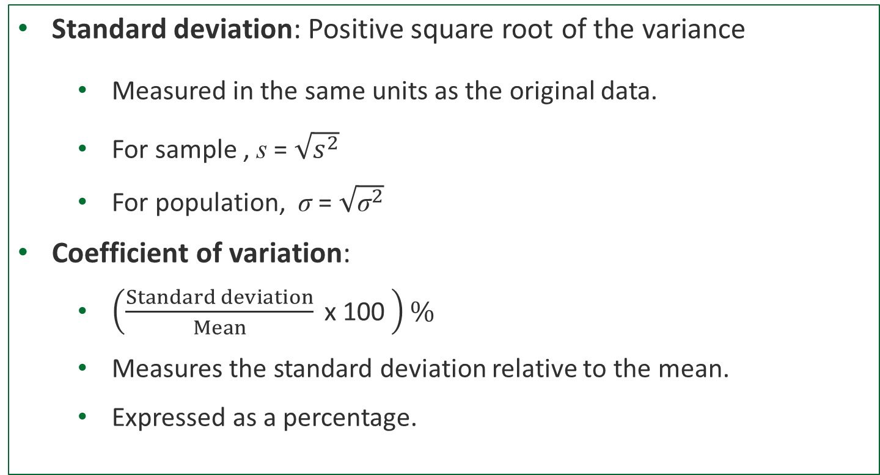
Measures of Variability
Standard deviation: Positive square root of the variance
Measured in the same units as the original data.
For sample , s = $\sqrt{s^{2}}$
For population, σ = $\sqrt{{\text{σ}}^{2}}$
Coefficient of variation:
$\left(\frac{Standard deviation}{Mean} \text{x}\text{ 100 }\right)\%$
Measures the standard deviation relative to the mean.
Expressed as a percentage.

Slide 48
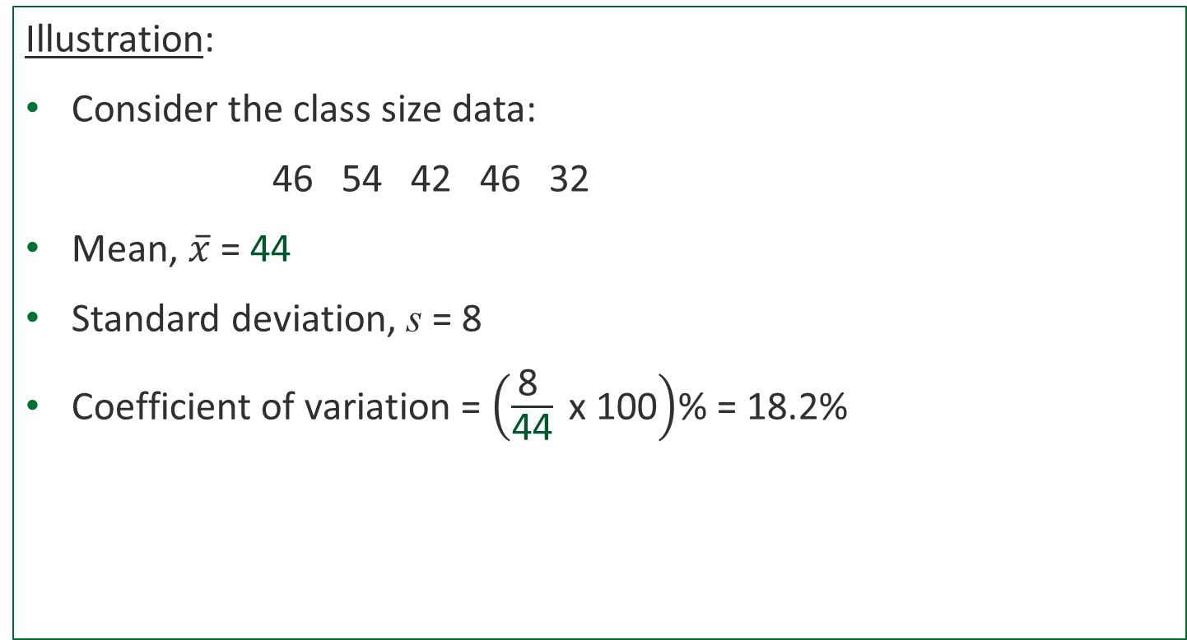
Computation of Coefficient of Variation
Illustration:
Consider the class size data:
46 54 42 46 32
Mean, $\overline{x}$ = 44
Standard deviation, s = 8
Coefficient of variation = $\left(\frac{\text{8 }}{\text{44}} \text{x}\text{ 100}\right)$% = 18.2%
Notes:
The coefficient of variation tells that the sample standard deviation is 18.2 percent of the value of the sample mean.

Slide 49
Additional Reading –
Measures of Association Between Two Variables

Slide 50
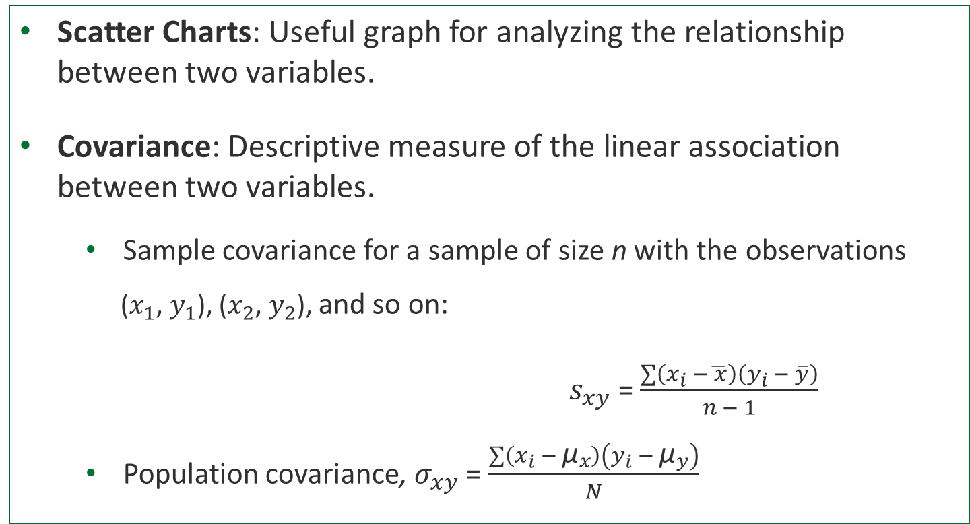
Measures of Association Between Two Variables
Scatter Charts: Useful graph for analyzing the relationship between two variables.
Covariance: Descriptive measure of the linear association between two variables.
Sample covariance for a sample of size n with the observations
($x_{1}$, $y_{1}$), ($x_{2}$, $y_{2}$), and so on:
$s_{xy}$ = $\frac{\sum{\left(x_{i} −\overline{ x}\right)\left(y_{i} − \overline{y}\right)}}{n − 1}$
Population covariance, $σ_{xy}$ = $\frac{\sum{\left(x_{i} − {\text{µ}}_{x}\right)\left(y_{i} − {\text{µ}}_{y}\right)}}{N}$
Second variable
First variable

Slide 51
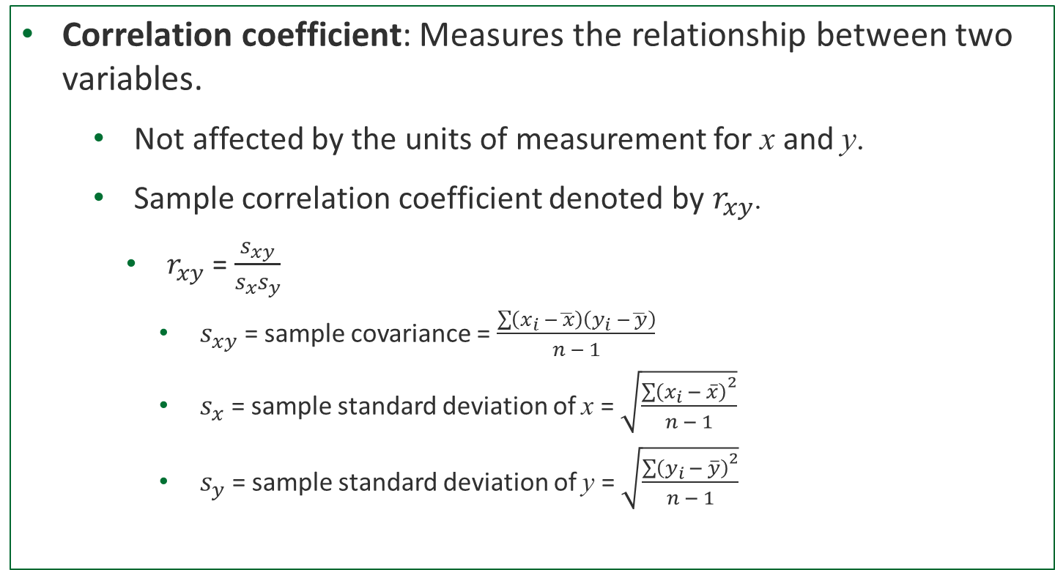
Measures of Association Between Two Variables
Correlation coefficient: Measures the relationship between two variables.
Not affected by the units of measurement for x and y.
Sample correlation coefficient denoted by $r_{xy}$.
$r_{xy}$ = $\frac{s_{xy}}{s_{x}s_{y}}$
$s_{xy}$ = sample covariance = $\frac{\sum{\left(x_{i} −\overline{ x}\right)\left(y_{i} −\overline{ y}\right)}}{n − 1}$
$s_{x}$ = sample standard deviation of x = $\sqrt{\frac{{\sum{\left(x_{i} − \overline{x}\right)}}^{2}}{n − 1}}$
$s_{y}$ = sample standard deviation of y = $\sqrt{\frac{{\sum{\left(y_{i }− \overline{y}\right)}}^{2}}{n − 1}}$
Notes:
Population correlation coefficient is denoted by $ρ_{xy}$.
$ρ_{xy}$ = $\frac{σ_{xy}}{σ_{x}σ_{y}}$
$σ_{xy}$ = population covariance = $\frac{\sum{\left(x_{i} − {\text{µ }}_{x}\right)\left(y_{i} − {\text{µ }}_{y}\right)}}{N}$.
$σ_{x}$ = population standard deviation of x = $\sqrt{\frac{{\sum{\left(x_{i} −{\text{µ }}_{x}\right)}}^{2}}{N}}$.
$σ_{y}$ = population standard deviation of y = $\sqrt{\frac{{\sum{\left(y_{i} −{\text{µ }}_{y}\right)}}^{2}}{N}}$.

Slide 52
Interpretation of Correlation Coefficient
–1 ≤ r ≤ +1
r value | Relationship between the x and y variables
< 0 | Negative linear
Near 0 | No linear relationship
> 0 | Positive linear
Notes:
The closer the correlation coefficient is to +1, the closer the x and y values are to forming a straight line that trends upward to the right (positive slope).
The closer the correlation coefficient is to –1, the closer the x and y values are to forming a straight line with negative slope.

Slide 53
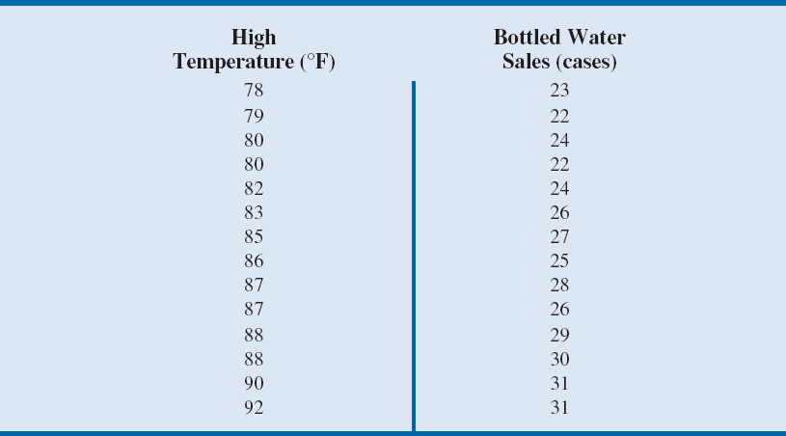
Table 2.14 - Data for Bottled Water Sales at Queensland Amusement Park for a Sample of 14 Summer Days

Slide 54
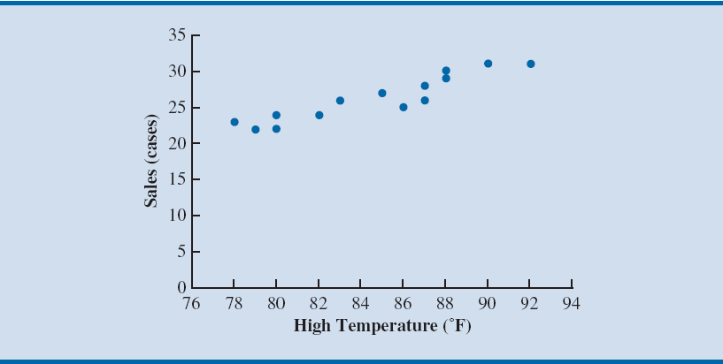


Figure 2.23 - Chart Showing the Positive Linear Relation Between Sales and High Temperatures
Positive relation
Notes:
The scatter chart in the figure suggests that daily high temperatures are associated with higher bottled water sales.
This is an example of a positive relationship because when one variable (high temperature) increases, the other variable (sales of bottled water) generally also increases.
The scatter chart also suggests that a straight line could be used as an approximation for the relationship between high temperature and sales of bottled water.

Slide 55
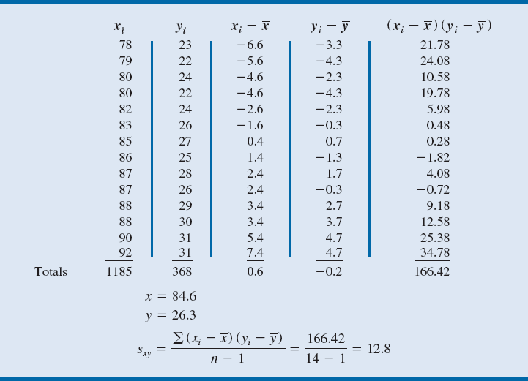
Table 2.15 - Sample Covariance Calculations for Daily High Temperature and Bottled Water Sales at Queensland Amusement Park
Notes:
Because the covariance is greater than 0, it indicates a positive relationship between the high temperature and sales of bottled water.
This verifies the relationship in the scatter chart in Figure 2.23 that as the high temperature for a day increases, sales of bottled water generally increase.
If the covariance is near 0, then the x and y variables are not linearly related.
If the covariance is less than 0, then the x and y variables are negatively related, which means that as x increases, y generally decreases.

Slide 56
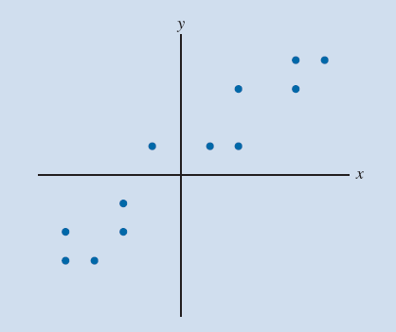
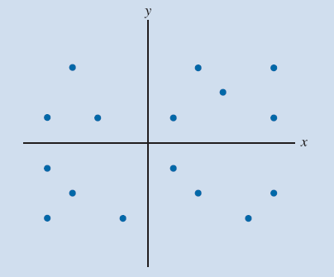
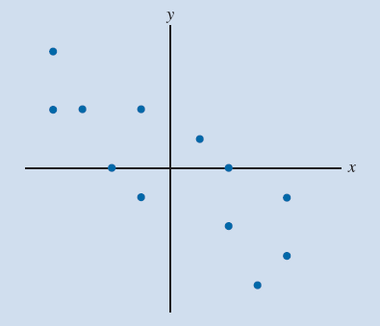
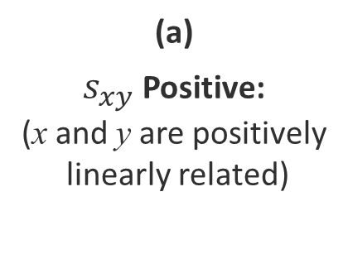
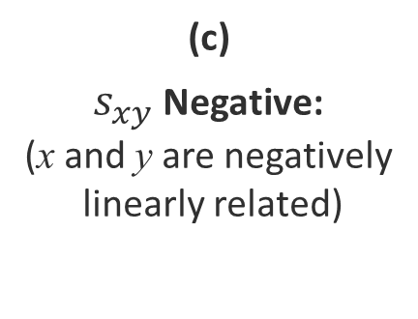
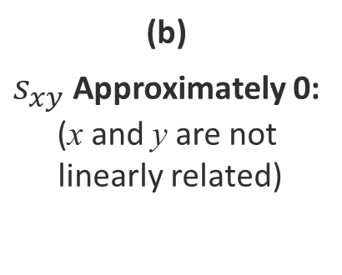
Figure 2.25 - Scatter Diagrams and Associated Covariance Values for Different Variable Relationships
(a)
$s_{xy}$ Positive:
(x and y are positively
linearly related)
(b)
$s_{xy}$ Approximately 0:
(x and y are not
linearly related)
(c)
$s_{xy}$ Negative:
(x and y are negatively
linearly related)

Slide 57
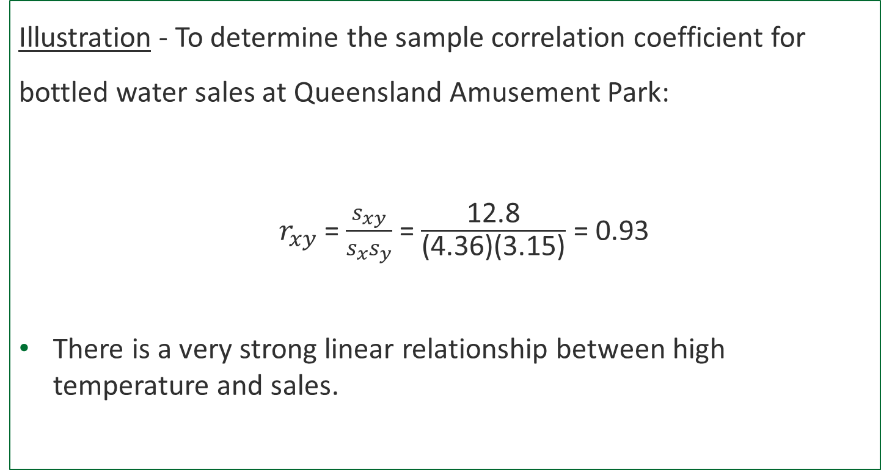
Computation of Correlation Coefficient
Illustration - To determine the sample correlation coefficient for bottled water sales at Queensland Amusement Park:
$r_{xy}$ = $\frac{s_{xy}}{s_{x}s_{y}}$ = $\frac{\text{12.8}}{\text{(4.36)(3.15)}}$ = 0.93
There is a very strong linear relationship between high temperature and sales.
Notes:
We have already obtained the value of $s_{xy}$ as 12.8.
Using data in Table 2.14, we can compute sample standard deviations for x and y.
${ s}_{x}\text{=}\sqrt{\frac{{\sum{\left(x_{i}−\overline{x}\right)}}^{2}}{n−1}}$ = 4.36
$s_{y}\text{=}\sqrt{\frac{{\sum{\left(y_{i}−\overline{y}\right)}}^{2}}{n−1}}$ = 3.15

Slide 58
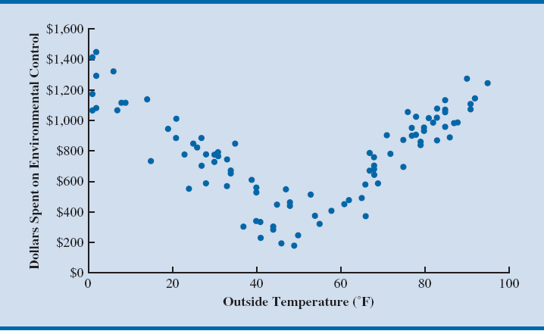
Figure 2.26 - Example of Nonlinear Relationship Producing a Correlation Coefficient Near Zero
Notes:
The scatter diagram in Figure 2.26 shows the relationship between the amount spent by a small retail store for environmental control (heating and cooling) and the daily high outside temperature over 100 days.
The sample correlation coefficient for these data is r_{xy} = –0.007 and indicates that there is no linear relationship between the two variables.
However, Figure 2.26 provides strong visual evidence of a nonlinear relationship.
That is, we can see that as the daily high outside temperature increases, the money spent on environmental control first decreases as less heating is required and then increases as greater cooling is required.

Slide 59

Conclusion and Notes
This chapter helps you understand what the standard techniques for data summarization are.
Note that you are NOT required to:
Read Section 2.7 and Chapter 2 Appendix.
Use MS Excel in this course.

